Slide 1
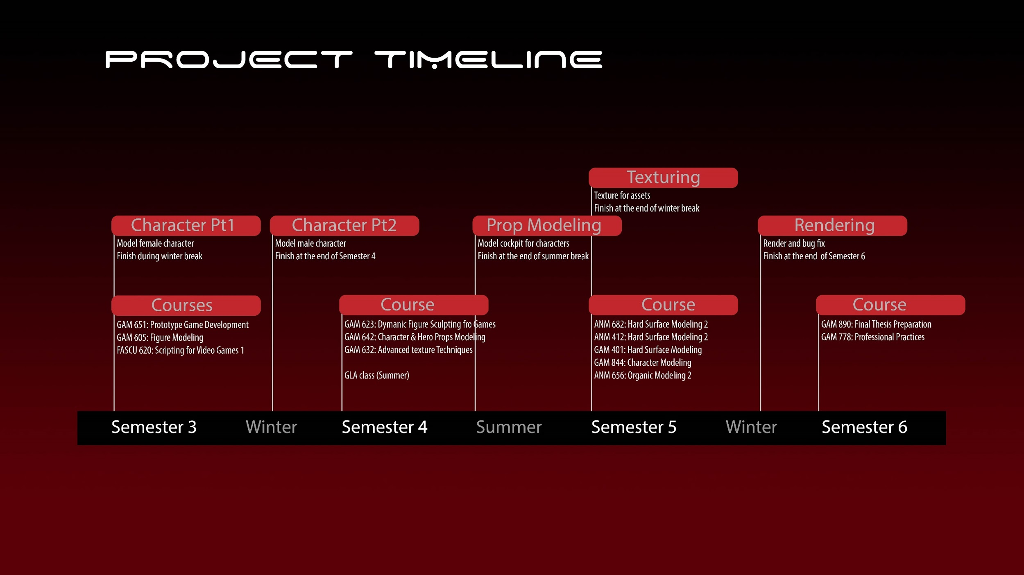

Slide 2
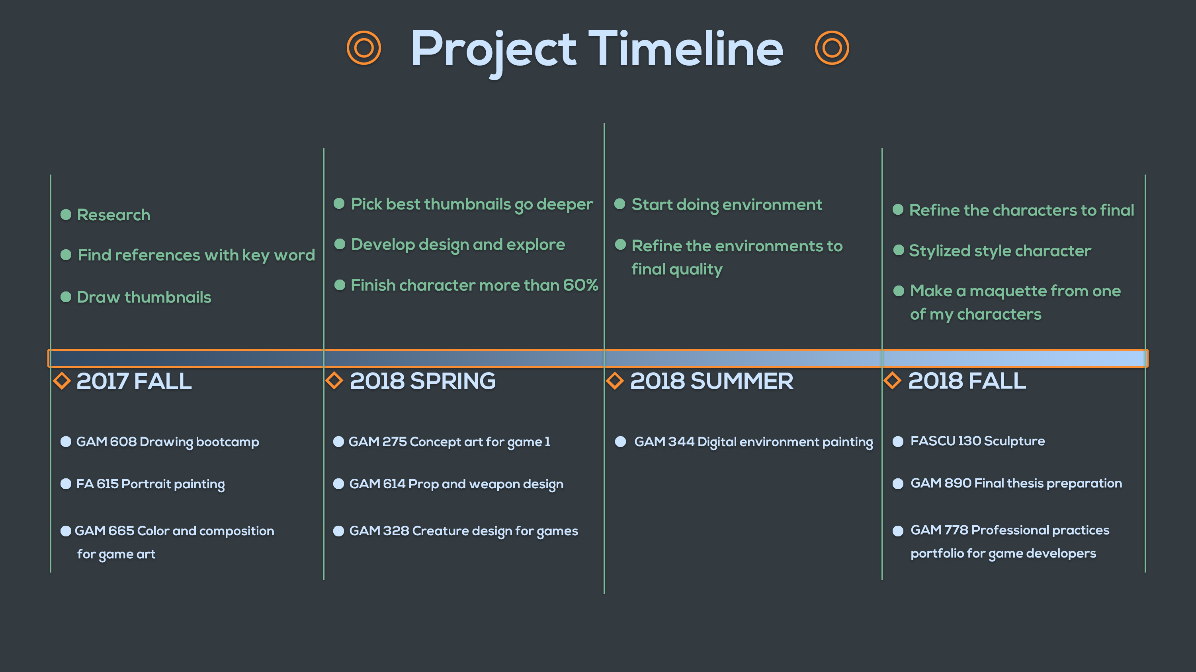
SEMESTER 6

Slide 3
Project Timeline
Environment Design
ANM 605: Layout Design for Animations
GAM 665: Color & Composition FOR GAME ART
Or IAD 603: Sketching & Perspective for Interior Environments
Character Design
GAM 614: Prop & Weapon Ideation for Games
Or GAM 260: Prop Design & Drawing for Games
Thumbnails
GAM 244: Digital Environment Sketching
Reference Research
Ideas Organization
Week 1
5
10
15
20
25
30
35
40
45
Semester 1
Semester 2
Semester 3

Slide 4
Course Timeline
Semester 1
GAM 610: Drawing Bootcamp: Dynamic Sketching
DS GAM 244: Digital Environment Sketching
DS GAM 614: Prop & Weapon Ideation for Games
or GAM 260: Prop Design & Drawing for Games
Semester 2
DS GAM 860: Concept Art for Games
DS ANM 605: Layout Design for Animations
or IAD 603: Sketching & Perspective for Interior Environments
DS GAM 665: Color & Composition for Game Art
Semester 3
DS GAM 890: Final Thesis Preparation
GAM 778: Professional Practices & Portfolio for Game Developers
or ANM 770: Final Portfolio Preparation

